Slide 1
Energy Consumption Analysis and Efficiency Improvement
Jaypee University Of Engineering and Technology
TEAM MEMBERS
LOKENDRA SAHU 221B221
MAHIPAL PRATAP SINGH TOMAR 221B225
MANOJ KUMAR LODHA 221B231
Project no : AK6
Guided by : dr. aJAY kUMAR

Slide 2
Content
Introduction
Requirement analysis
Block diagram of project
Result
Conclusion
Infosys Springboard Courses

Slide 3
Introduction
Data Science is a field that involves using scientific methods, algorithms, and systems to extract knowledge and insights from structured and unstructured data. It combines statistics, mathematics, programming, and domain expertise to solve complex problems.
Applications of Data Science:
Healthcare: Predicting disease outbreaks, personalized medicine, and improving patient care.
Finance: Fraud detection, risk management, and algorithmic trading.
Retail: Customer behavior analysis, inventory management, and recommendation systems.
Transportation: Optimizing routes, predicting traffic patterns, and autonomous vehicles.

Slide 4
Introduction
🌍 In the dynamic world of energy usage, optimizing consumption is both a necessity and a challenge. But fear not! Our data science project aims to act as a beacon—guiding individuals and policymakers toward smarter, sustainable energy practices.
🔋 Energy Efficiency: Leveraging cutting-edge machine learning to understand and optimize household energy consumption.
📊 Data Insights: Utilizing datasets like the UCI Energy Efficiency Dataset for actionable strategies.
🌱 Sustainability Impact: Connecting micro-level insights with national-level trends for a comprehensive solution.
e of books, finding the perfect read can be both exciting and overwhelming. But fear not! Our dd books they’ll love.

Slide 5
Requirement analysis
Data Source: Utilizes a rich dataset from UCI Energy Efficiency Dataset .
Techniques Used: Involves data preprocessing, feature engineering, and machine learning
Methodology: exploratory data analysis (EDA).
Tools Utilized: Leverages Python, Jupyter Lab, and scikit-learn for data manipulation, model building, and evaluation, streamlit for user interface.
Goal : Enhance energy efficiency and sustainability by providing accurate predictions and actionable insights for energy consumption at household and national levels..

Slide 6
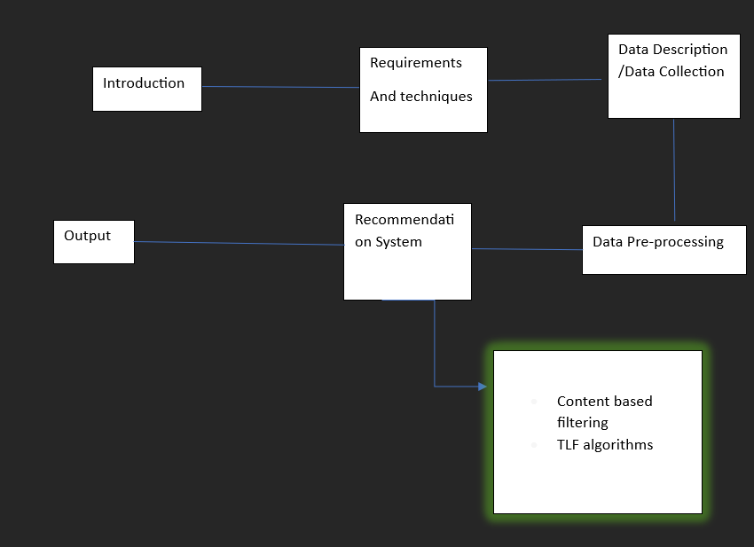
Block diagram
Fig.1 Block diagram

Slide 7
Data Collection
The UCSD Goodreads Dataset is a comprehensive collection of data from the Goodreads book review website, curated by researchers at the University of California, San Diego (UCSD).
Here are some key features of the dataset:
User Interactions: Includes data on user ratings, reviews, and book shelves .
“goodreads_interactions. csv”
Book Attributes: Contains information about books, such as titles, authors, genres, and series.
“goodreads_books. json”
Rich Metadata: Provides additional details like book descriptions and publication dates.

Slide 8
Data Description
1. Machine_Learning_to_predict_Energy_Consumption.ipynb
Description: The primary Jupyter Notebook that contains the code and detailed explanations for predicting energy consumption using machine learning models, specifically using LSTM networks.
Contents: Data loading, preprocessing, model building, evaluation, and visualization.

Slide 9
Data Description
Data
Description: A directory that holds the datasets required for training and testing the machine learning models.
Expected Contents: CSV or other data files containing historical energy consumption data and possibly other relevant features like weather, time, and geographic location.
Models
Description: A folder for storing the trained machine learning models, likely saved in formats such as .h5 for Keras or .pkl for Scikit-learn models.
Expected Contents: Trained models that can be used for inference or further analysis.

Slide 10
Data pre-processing
Normalization: Scale numerical features like energy readings (e.g., Global_active_power, Voltage) to a consistent range and aggregate data (e.g., hourly/daily) for efficient processing.
Feature Extraction: Extract meaningful insights such as peak usage hours, appliance contributions (from sub-metering), and environmental impacts (correlation with temperature/humidity).
Encoding: Convert categorical data (e.g., appliance types, time-of-day) into numerical forms using techniques like one-hot or label encoding, and derive time-based features (hour, day, month) for temporal analysis.

Slide 11
Exploratory Data Analysis
Purpose: Understand consumption trends and seasonal variations.
Visual Insights:
Yearly consumption trends showing variations over time.
Monthly and hourly analysis reveals peak consumption times.
Boxplots highlight outliers and typical usage patterns.
Key Takeaways:
Clear evidence of seasonality in energy usage.
Hourly consumption peaks during specific times of the day.

Slide 12
Model Architecture and Training
Model Type: LSTM Neural Network for time-series data.
Architecture Details:
Input layer for historical time-series data.
LSTM layers to capture temporal dependencies.
Dropout layers to prevent overfitting.
Dense layers for generating final predictions.
Training Process:
Normalized data for efficient model training.
Split data into training (70%), validation (15%), and test (15%) sets.
Optimized model using Mean Squared Error (MSE) loss function.

Slide 13
Model Evaluation
Root Mean Squared Error (RMSE): Measures prediction accuracy.
Training and Validation Loss: Indicates model convergence over epochs.
Results Visualization:
Comparison of actual vs. predicted values shows strong alignment.
Loss graph demonstrates model stability after training.

Slide 14
Predictions and Forecasting
Next 30-Day Forecast:
Used trained LSTM model to predict future energy consumption.
Provided visual overlay of predicted vs. actual energy usage for test data.
Visualization Details:
Line graph of forecasted daily consumption for the next month.
Clear trend patterns matching historical data trends.

